Slide 1
SBA’s Contracting Resources for Women-Owned Businesses
Erin Andrew
Assistant Administrator
SBA’s Office of Women’s Business Ownership May 26, 2015

Slide 2
Women-Owned Firms Continue to Grow
Women-owned business generate over $1.3 trillion ($2.7 trillion*) in revenues and employ nearly 7.8 million (16 million*) people
Between 1997 and 2013, the number of women-owned firms grew by 59%
Despite these findings, women-owned businesses employ just 6% of the nation’s workforce and contribute less than 4% of business revenues
Women entrepreneurs are found in higher concentrations among retail sales and services industries and are more likely to be organized as proprietorships
30% of enterprises in the U.S. are women-owned

Slide 3
SBA’s Office of Women’s Business Ownership
Mission: To help women entrepreneurs start, grow and compete in global markets by providing quality support with access to capital, access to markets, job creation and growth and counseling and training by:
SMART
BOLD
ACCESSIBLE
Program Management and Oversight
Partnerships, Collaboration and Outreach
Leveraging and Expanding on Existing Programs
1
2
3
Fostering participation of women entrepreneurs in the economy by overseeing a $14M grant program of 107 Women’s Business Centers (WBCs) throughout the U.S. and territories
Creating public-private partnerships to support women entrepreneurs and conducting outreach and education to existing and nascent women-owned/led businesses
Working with SBA programs to ensure women are well represented and being served and identify gaps where women could increase participation

Slide 4
Ensuring Small Firms Get Government Contracts
$90B portfolio of loan guarantees through 5,000 lenders
$2.6B in growth capital via Small Business Investment Companies (SBIC)
Capital
Ensuring 23% of federal contracts go to small firms ($100B annually)
5% to women-owned firms
5% to small disadvantaged businesses
3% to HUBZone companies
3% to service-disabled veteran-owned firms
Contracting
Free and low cost counseling and training to 1million entrepreneurs per year
107 Women’s Business Centers; 68 field and regional offices; 1,000 Small Business Development Centers; 12,000 SCORE volunteers
Counseling

Slide 5
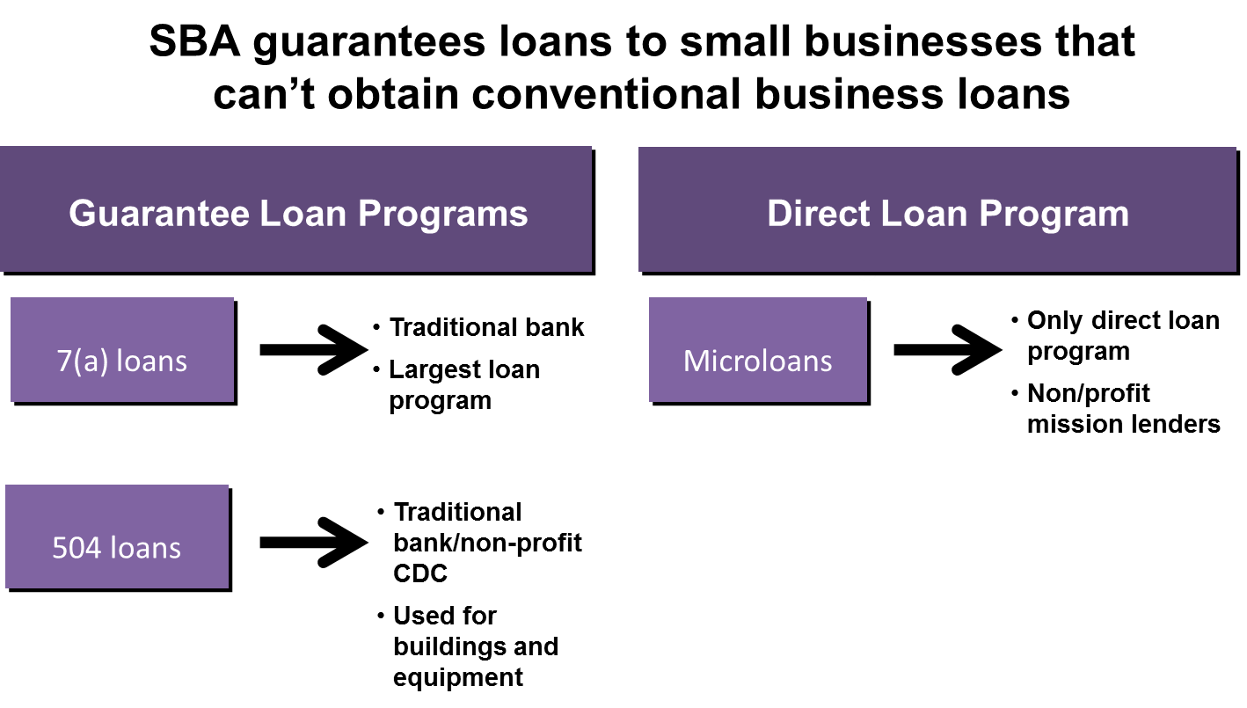
Capital: SBA works with banks, mission based lenders and others to provide capital

Slide 6
Capital: The majority of SBA’s lending portfolio is from the 504 and 7a products
SBA guarantees loans on reasonable terms through financing partners to small businesses that are unable to obtain funding from conventional lenders.
SBA 504 Loan Program
Provides small businesses with long-term, fixed rate financing
Used to acquire fixed assets for expansion or modernization
The maximum 504 loan size is $5 million
SBA 7(a) Loan Program
Provides financial help to small businesses with specific requirements
These include loans to businesses in underserved communities, rural areas, and loans for businesses developing export programs.

Slide 7
Capital: Changes to SBA’s Access to Capital Programs Help Women
Credit Scoring Tool: SBA has implemented streamlined underwriting guidelines that include credit scoring for loans under $350,000, that especially benefit underserved communities
LINC: SBA launched first phase of LINC in February providing a platform for borrowers and lenders to connect (www.sba.gov/tools/linc)
SBAOne: Single platform that will streamline SBA’s core services making it easier for lending partners to process loans
Fee Reductions: Fees waived on 7a loans under $150,000

Slide 8
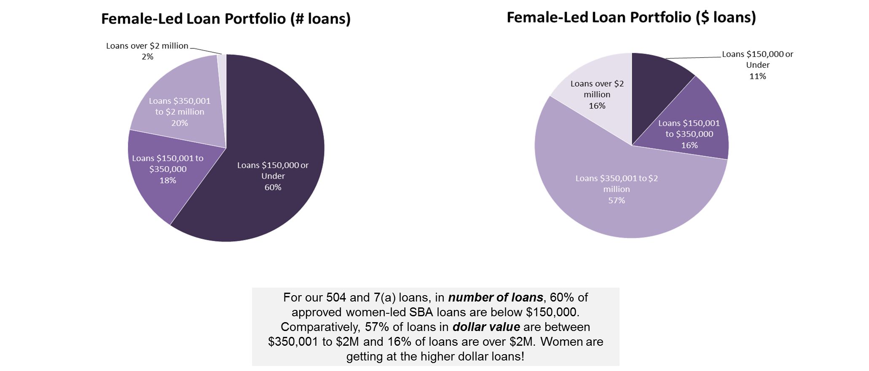
Women’s Lending Data – SBA Cap Access Trends FY09 – FY14

Slide 9
Capital: SBA also supports High Growth Companies through the Small Business Investment Company Program
SBA-guaranteed bonds match private capital raised by privately-owned and managed investment funds. They serve as catalysts for accelerating capital support for start-ups and high-growth firms.
Through the Start-Up America Initiative, SBA has committed $2 billion as a match to private investment to target high-growth business expansion through the existing SBIC structure.
$1B Impact Investment Fund
Invests growth capital in companies in underserved areas
Matches private capital; targets “impact” investments
$1B Early-Stage Innovation Fund
1:1 match to private capital raised by early-stage seed funds to help early stage companies access capital
Good opportunity for small firms in the bioscience industry

Slide 10
Contracting: SBA Works with the Federal Government to Ensure Small Businesses get Contracts
SBA’s Office of Business Development and Government Contracting is responsible for getting federal contracting dollars into the hands of small and disadvantaged businesses.
By statute, 23% of all federal government prime contracting dollars must go to small businesses.
SBA also helps ensure that prime contracting dollars go to disadvantaged small businesses:
Small disadvantaged businesses (SDBs): 5%
Women-owned small businesses: 5%
Service-disabled veterans: 3%
Historically-Underutilized Business Zones (HUBZones): 3%.

Slide 11
Contracting: Women Have Additional Opportunities Through the WOSB Contracting Program
General Program Details:
The WOSB Program went into effect in 2011 and since then SBA has held a number of training and outreach events to assist small businesses and contracting officers with understanding the program and its requirements.
Incremental growth in WOSB spending through both program set-aside and non-set-aside contracts
2011 – 3.98% ($16.8B)
2012 – 4.00% ($16.2B)
2013 – 4.32% ($15.4B)
Eligibility Requirements for the Program:
At least 51% percent unconditionally and directly owned and controlled by one or more women who are United States citizens.
A woman must manage the day-to-day operations, make long-term decisions for the business, hold the highest officer position in the business and work at the business full-time.
There is no minimum amount of time that you must be in business to be eligible, but there are requirements for managerial experience.

Slide 12
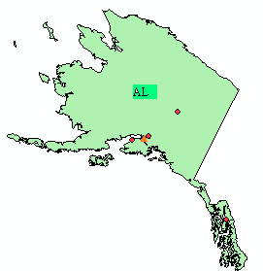
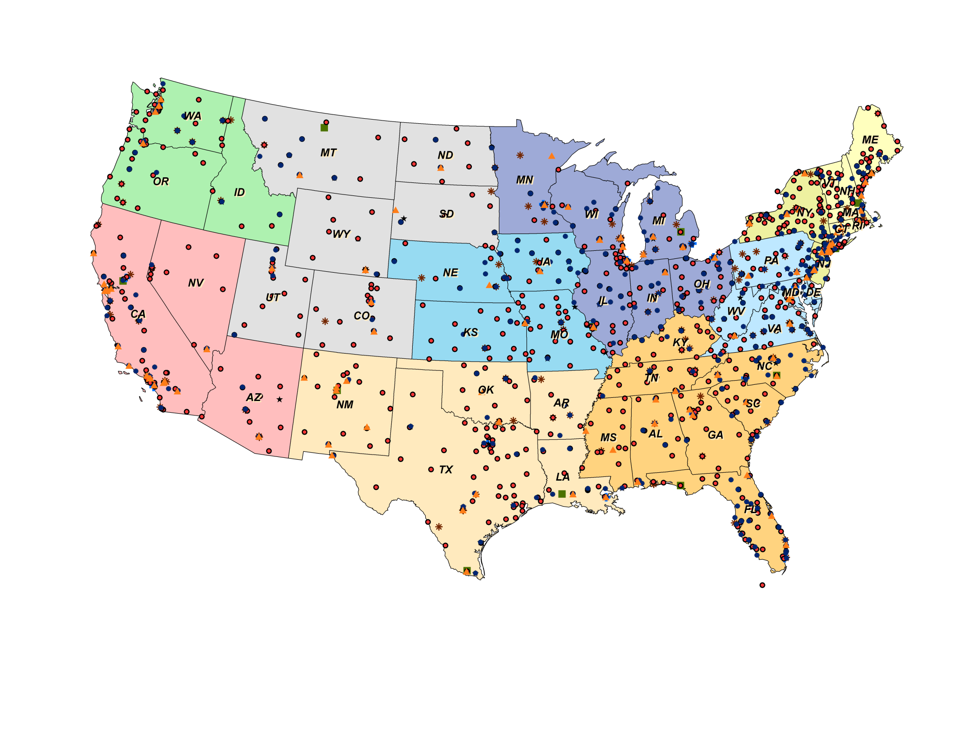
Counseling: SBA Provides Counseling through the WBCs, SBDCs and SCORE Networks
SBA Footprint
Legend
SBA District Offices (68)
Small Business Development Centers (938)
*
SCORE Centers (356)
Microlenders (199)
Women’s Business Centers (110)
U.S. Export Assistance Centers (19)
Veterans Business Outreach Centers (16)

Slide 13
Innovation: SBA also provides opportunities for high growth companies
SBA programs support small businesses seeking to research, develop and commercialize new technologies.
SBIR/STTR Programs
3-Phase program providing funding to small businesses for R&D leading to commercialization
Cluster Initiative
Linking research institutions, large organizations and small business to foster innovation and spur commercialization
Accelerators
SBA has invested in over 50 accelerators nationwide

Slide 14
Additional Resources
SBA.gov
SBA.gov/loans
SBA.gov/wosb

